Slide 1
Chapter 5: CPU Scheduling

Slide 2
Outline
Basic Concepts
Scheduling Criteria
Scheduling Algorithms
Thread Scheduling
Multi-Processor Scheduling
Real-Time CPU Scheduling
Operating Systems Examples
Algorithm Evaluation

Slide 3
Objectives
Describe various CPU scheduling algorithms
Assess CPU scheduling algorithms based on scheduling criteria
Explain the issues related to multiprocessor and multicore scheduling
Describe various real-time scheduling algorithms
Describe the scheduling algorithms used in the Windows, Linux, and Solaris operating systems
Apply modeling and simulations to evaluate CPU scheduling algorithms

Slide 4
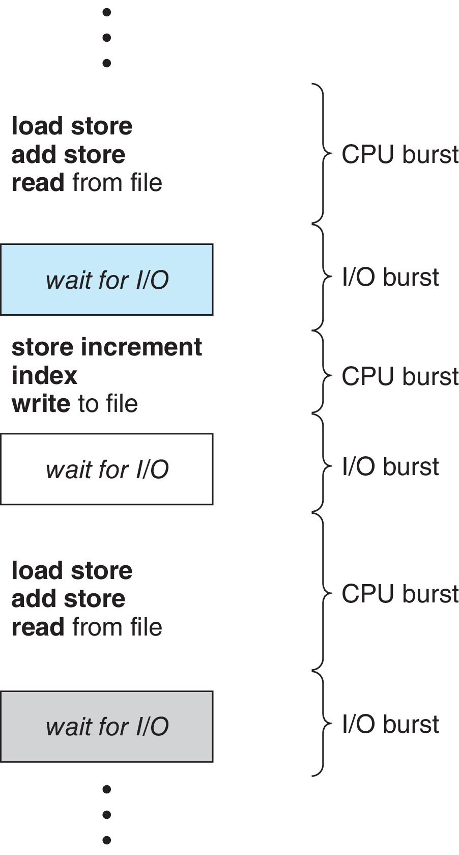
Basic Concepts
Maximum CPU utilization obtained with multiprogramming
CPU–I/O Burst Cycle – Process execution consists of a cycle of CPU execution and I/O wait
CPU burst followed by I/O burst
CPU burst distribution is of main concern

Slide 5
CPU Scheduler
The CPU scheduler selects from among the processes in ready queue, and allocates a CPU core to one of them
Queue may be ordered in various ways
CPU scheduling decisions may take place when a process:
1. Switches from running to waiting state
2. Switches from running to ready state
3. Switches from waiting to ready
Terminates
For situations 1 and 4, there is no choice in terms of scheduling. A new process (if one exists in the ready queue) must be selected for execution.
For situations 2 and 3, however, there is a choice.

Slide 6
Preemptive and Nonpreemptive Scheduling
When scheduling takes place only under circumstances 1 and 4, the scheduling scheme is nonpreemptive.
Otherwise, it is preemptive.
Under Nonpreemptive scheduling, once the CPU has been allocated to a process, the process keeps the CPU until it releases it either by terminating or by switching to the waiting state.
Virtually all modern operating systems including Windows, MacOS, Linux, and UNIX use preemptive scheduling algorithms.

Slide 7
Preemptive Scheduling and Race Conditions
Preemptive scheduling can result in race conditions when data are shared among several processes.
Consider the case of two processes that share data. While one process is updating the data, it is preempted so that the second process can run. The second process then tries to read the data, which are in an inconsistent state.
This issue will be explored in detail in Chapter 6.

Slide 8
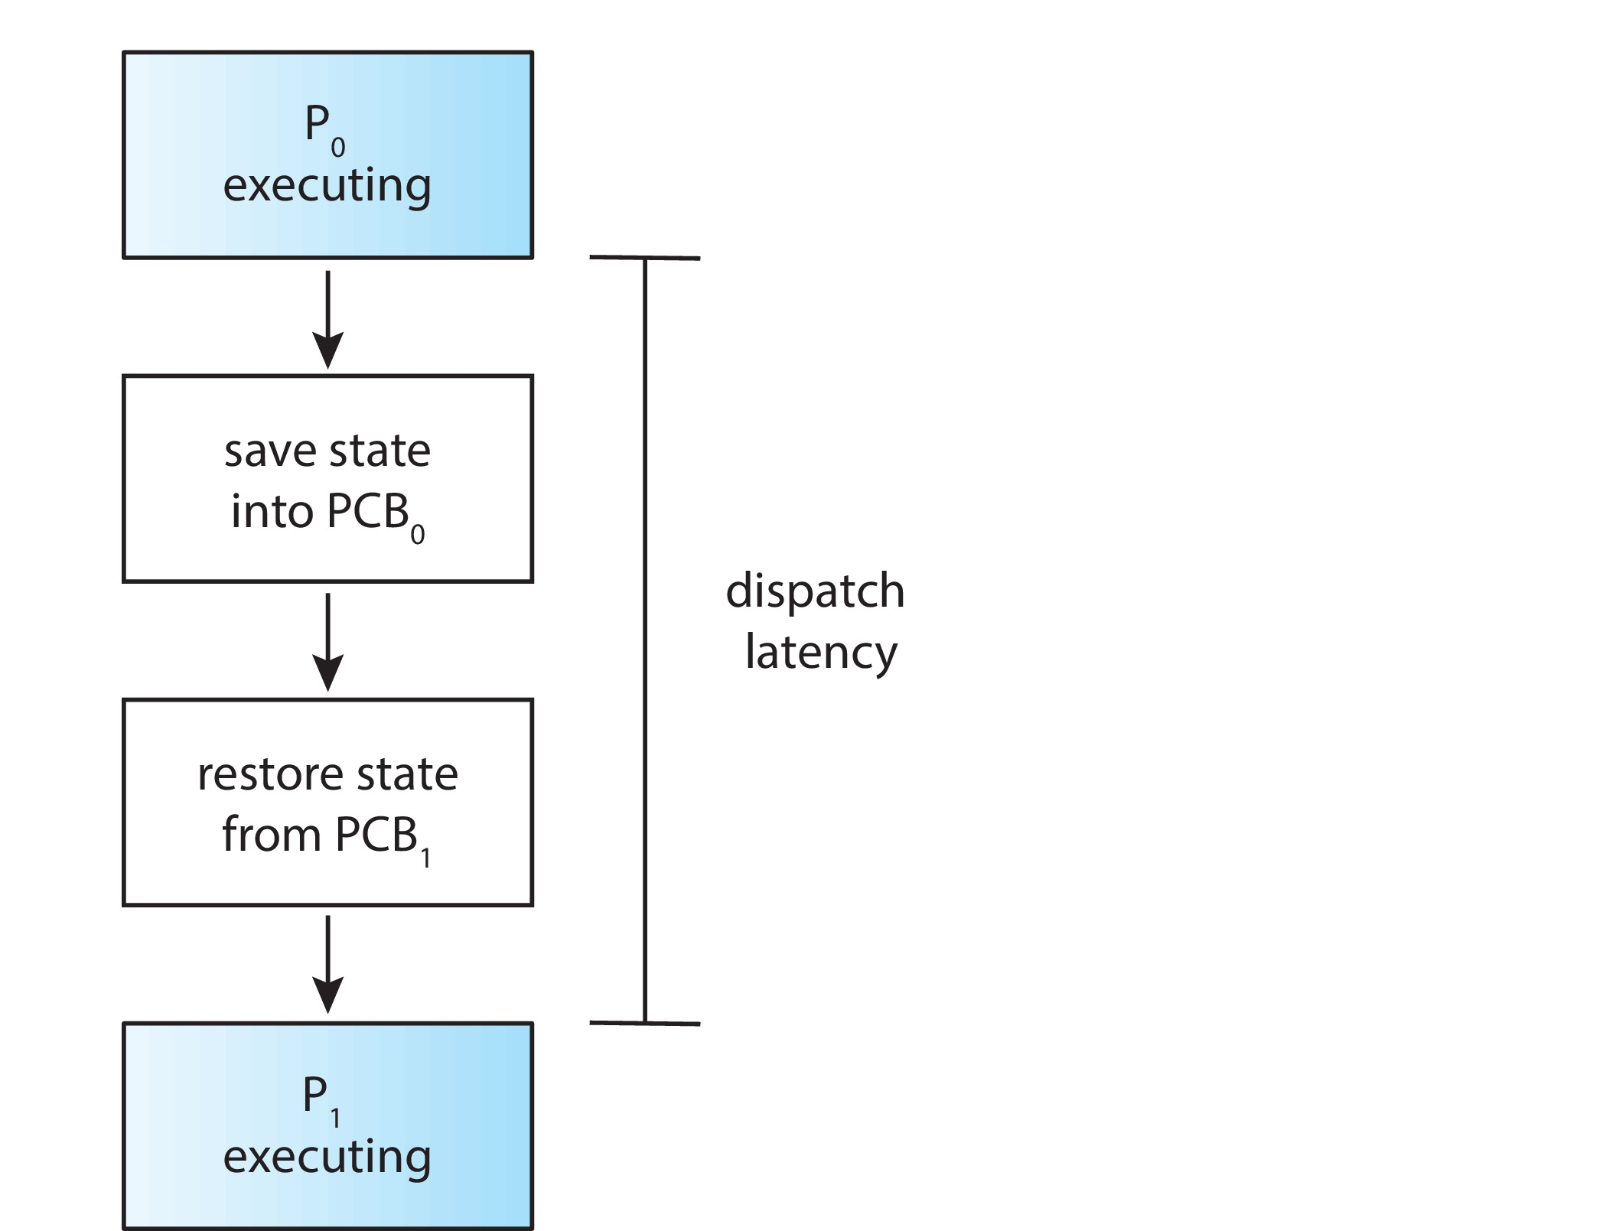
Dispatcher
Dispatcher module gives control of the CPU to the process selected by the CPU scheduler; this involves:
Switching context
Switching to user mode
Jumping to the proper location in the user program to restart that program
Dispatch latency – time it takes for the dispatcher to stop one process and start another running

Slide 9
Scheduling Criteria
CPU utilization – keep the CPU as busy as possible
Throughput – # of processes that complete their execution per time unit
Turnaround time – amount of time to execute a particular process
Waiting time – amount of time a process has been waiting in the ready queue
Response time – amount of time it takes from when a request was submitted until the first response is produced.

Slide 10
Scheduling Algorithm Optimization Criteria
Max CPU utilization
Max throughput
Min turnaround time
Min waiting time
Min response time

Slide 11
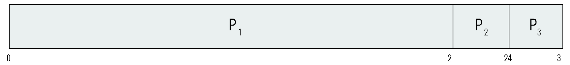
First- Come, First-Served (FCFS) Scheduling
Process Burst Time
P₁ 24
P₂ 3
P₃ 3
Suppose that the processes arrive in the order: P₁ , P₂ , P₃ The Gantt Chart for the schedule is:
Waiting time for P₁ = 0; P₂ = 24; P₃ = 27
Average waiting time: (0 + 24 + 27)/3 = 17

Slide 12
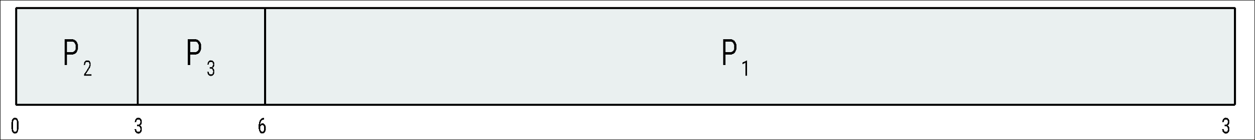
FCFS Scheduling (Cont.)
Suppose that the processes arrive in the order:
P₂ , P₃ , P₁
The Gantt chart for the schedule is:
Waiting time for P₁ = 6; P₂ = 0; P₃ = 3
Average waiting time: (6 + 0 + 3)/3 = 3
Much better than previous case
Convoy effect - short process behind long process
Consider one CPU-bound and many I/O-bound processes

Slide 13
Shortest-Job-First (SJF) Scheduling
Associate with each process the length of its next CPU burst
Use these lengths to schedule the process with the shortest time
SJF is optimal – gives minimum average waiting time for a given set of processes
Preemptive version called shortest-remaining-time-first
How do we determine the length of the next CPU burst?
Could ask the user
Estimate

Slide 14
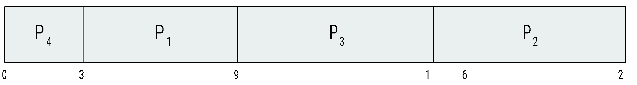
Example of SJF
Process Burst Time
P₁ 6
P₂ 8
P₃ 7
P₄ 3
SJF scheduling chart
Average waiting time = (3 + 16 + 9 + 0) / 4 = 7

Slide 15
Shortest Remaining Time First Scheduling
Preemptive version of SJN
Whenever a new process arrives in the ready queue, the decision on which process to schedule next is redone using the SJN algorithm.
Is SRT more “optimal” than SJN in terms of the minimum average waiting time for a given set of processes?

Slide 16
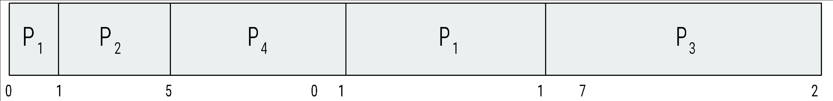
Example of Shortest-remaining-time-first
Now we add the concepts of varying arrival times and preemption to the analysis
Process i Arrival TimeT Burst Time
P₁ 0 8
P₂ 1 4
P₃ 2 9
P₄ 3 5
Preemptive SJF Gantt Chart
Average waiting time = [(10-1)+(1-1)+(17-2)+(5-3)]/4 = 26/4 = 6.5

Slide 17
Round Robin (RR)
Each process gets a small unit of CPU time (time quantum q), usually 10-100 milliseconds. After this time has elapsed, the process is preempted and added to the end of the ready queue.
If there are n processes in the ready queue and the time quantum is q, then each process gets 1/n of the CPU time in chunks of at most q time units at once. No process waits more than (n-1)q time units.
Timer interrupts every quantum to schedule next process
Performance
q large ⇒ FIFO (FCFS)
q small ⇒ RR
Note that q must be large with respect to context switch, otherwise overhead is too high

Slide 18
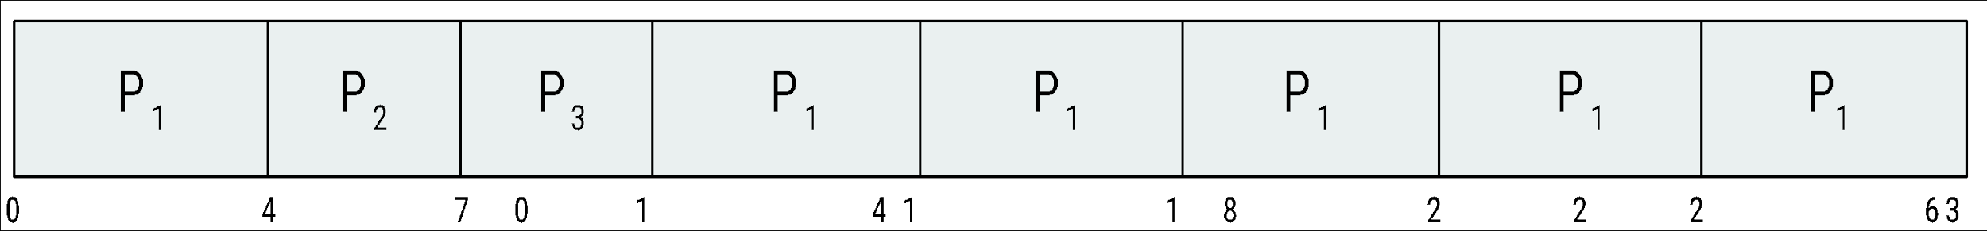
Example of RR with Time Quantum = 4
Process Burst Time
P₁ 24
P₂ 3
P₃ 3
The Gantt chart is:
Typically, higher average turnaround than SJF, but better response
q should be large compared to context switch time
q usually 10 milliseconds to 100 milliseconds,
Context switch < 10 microseconds

Slide 19
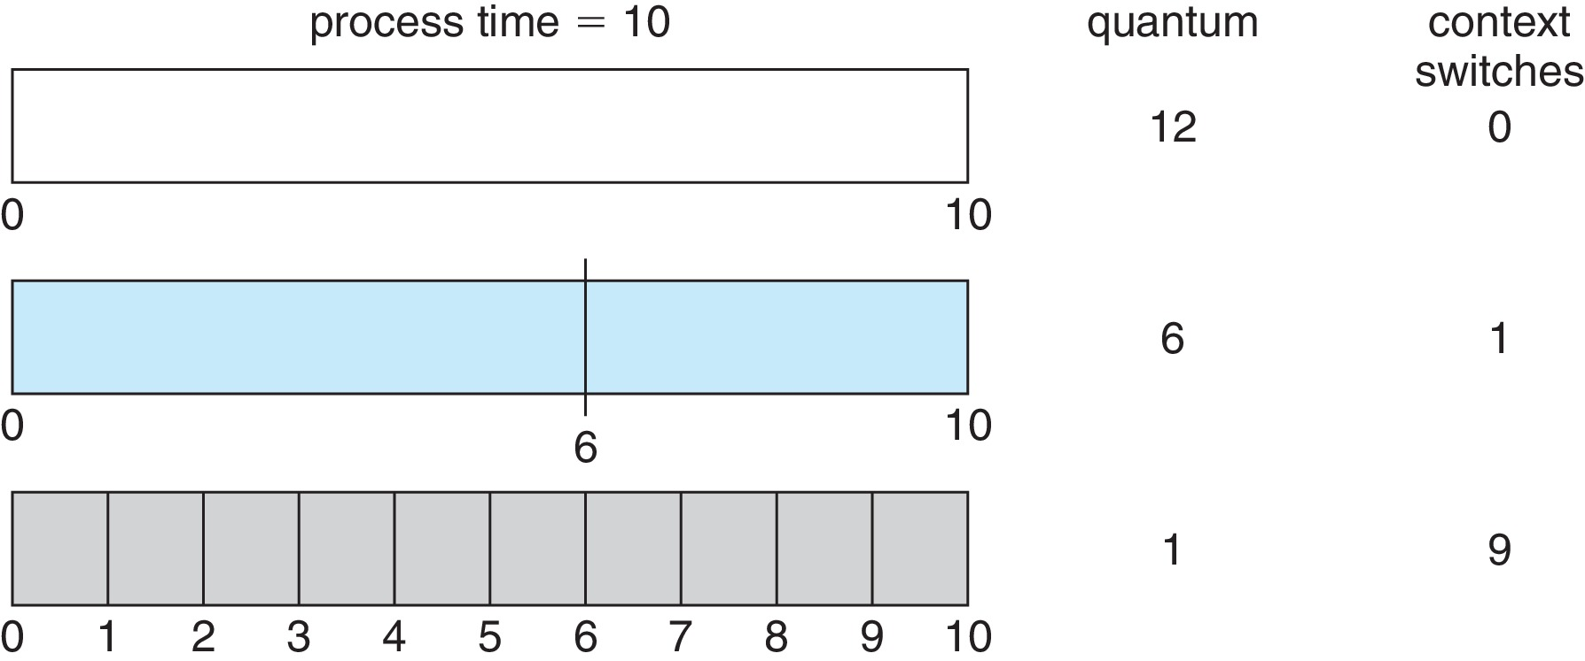
Time Quantum and Context Switch Time

Slide 20
Priority Scheduling
A priority number (integer) is associated with each process
The CPU is allocated to the process with the highest priority (smallest integer ≡ highest priority)
Preemptive
Nonpreemptive
SJF is priority scheduling where priority is the inverse of predicted next CPU burst time
Problem ≡ Starvation – low priority processes may never execute
Solution ≡ Aging – as time progresses increase the priority of the process

Slide 21
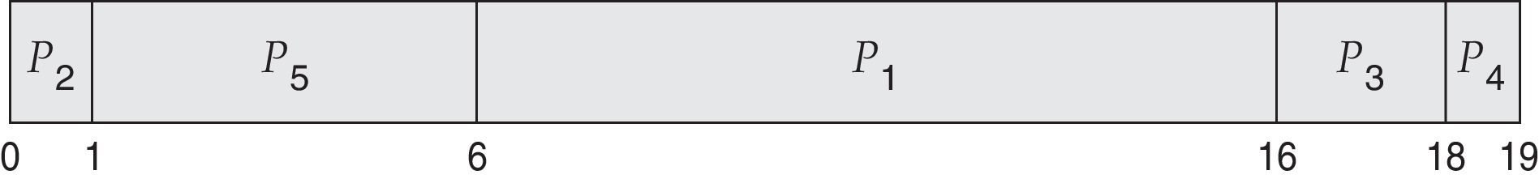
Example of Priority Scheduling
Process Burst Time Priority
P₁ 10 3
P₂ 1 1
P₃ 2 4
P₄ 1 5
P₅ 5 2
Priority scheduling Gantt Chart
Average waiting time = 8.2

Slide 22
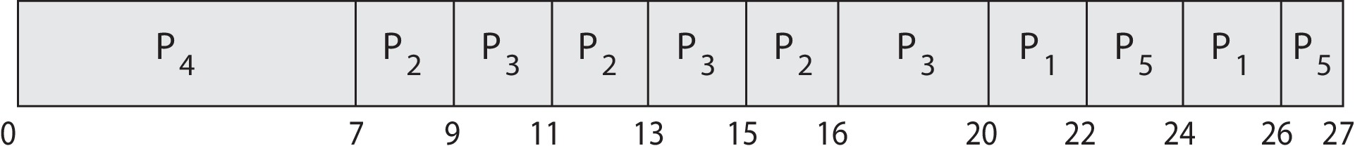
Priority Scheduling w/ Round-Robin
Run the process with the highest priority. Processes with the same priority run round-robin
Example:
Process a Burst Time Priority
P₁ 4 3
P₂ 5 2
P₃ 8 2
P₄ 7 1
P₅ 3 3
Gantt Chart with time quantum = 2

Slide 23
Multilevel Queue
The ready queue consists of multiple queues
Multilevel queue scheduler defined by the following parameters:
Number of queues
Scheduling algorithms for each queue
Method used to determine which queue a process will enter when that process needs service
Scheduling among the queues

Slide 24
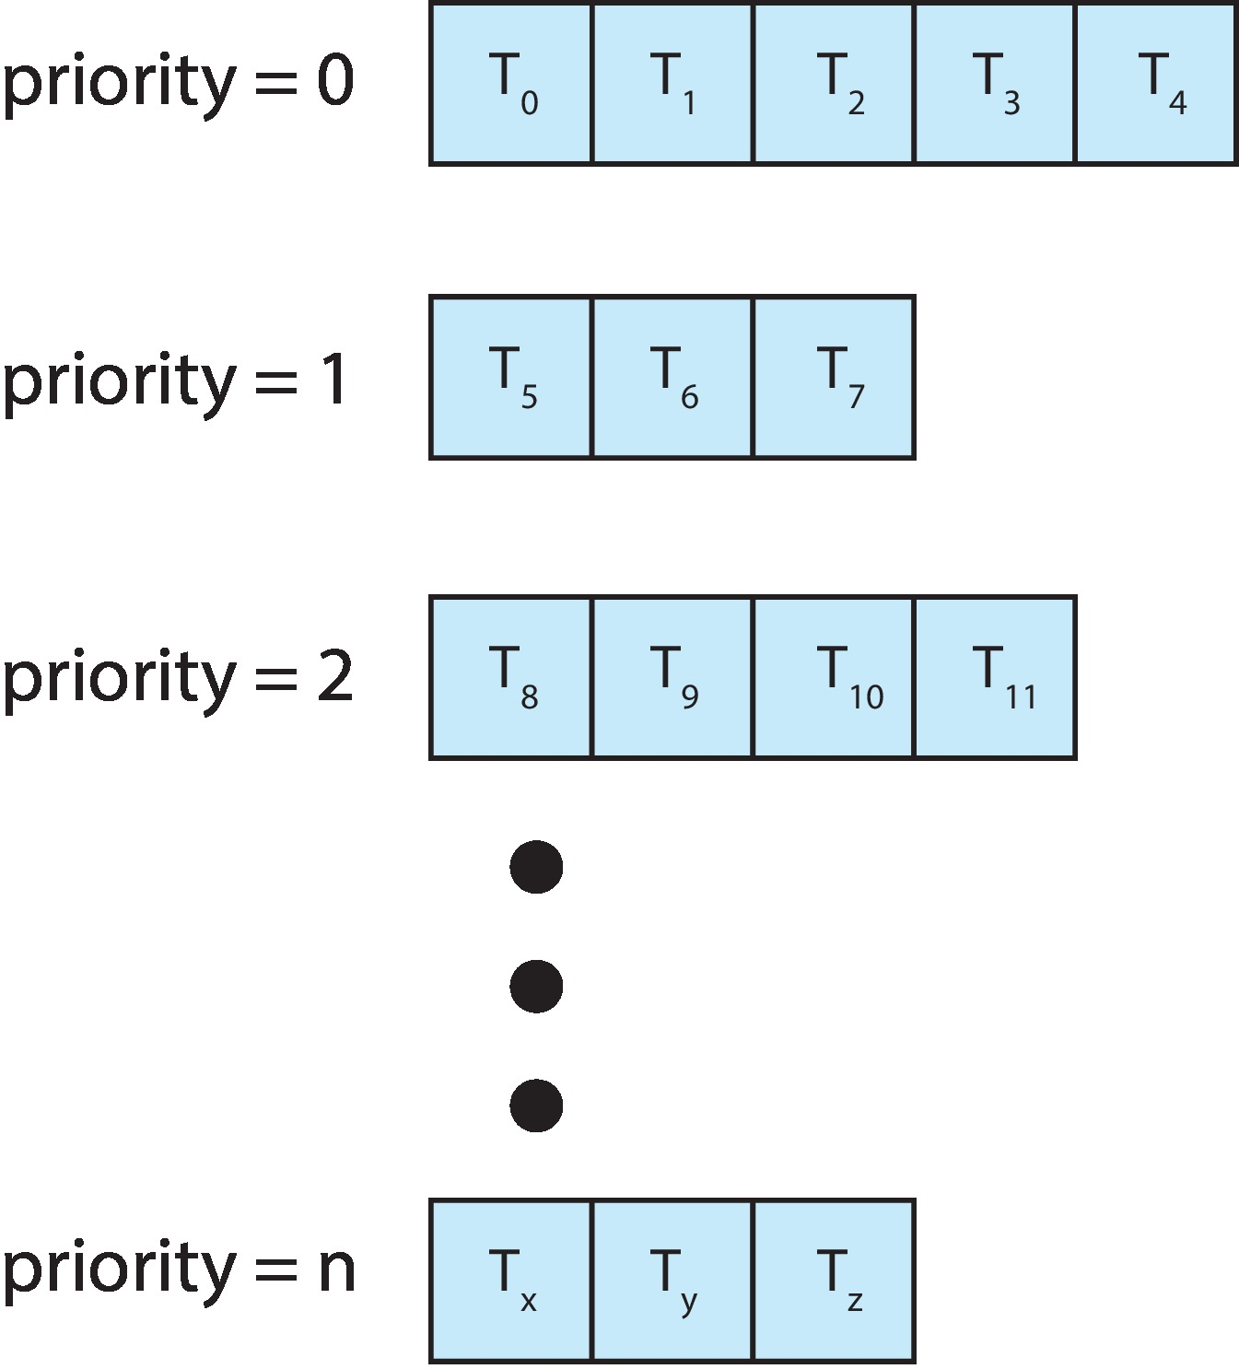
Multilevel Queue
With priority scheduling, have separate queues for each priority.
Schedule the process in the highest-priority queue!

Slide 25
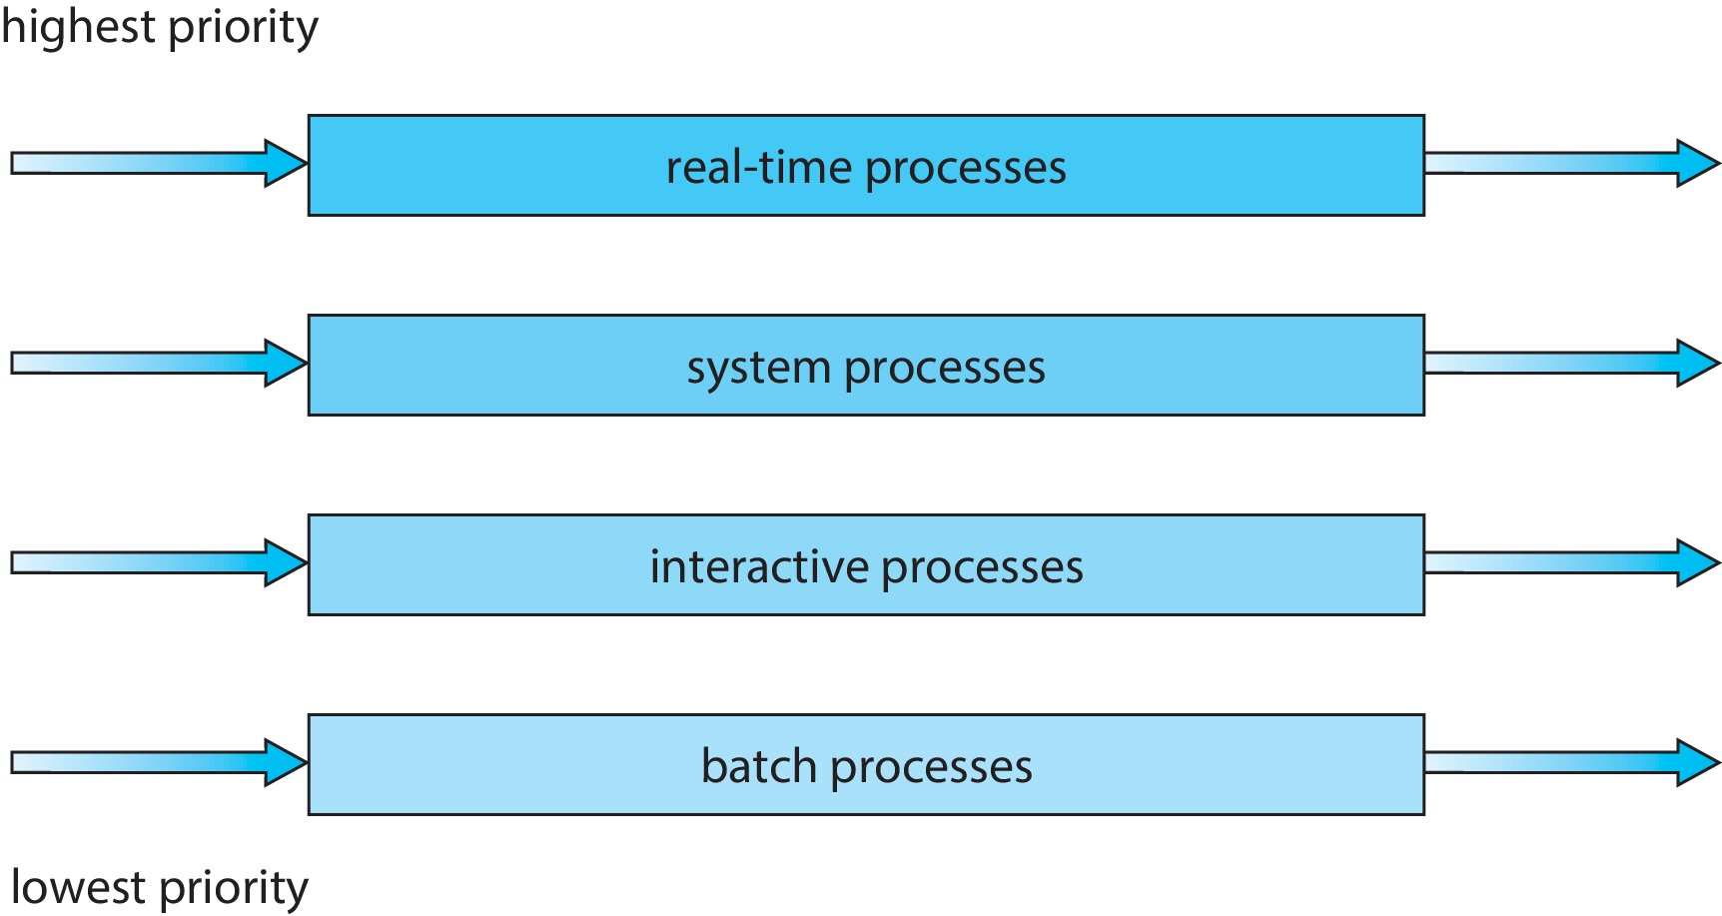
Multilevel Queue
Prioritization based upon process type

Slide 26
Multilevel Feedback Queue
A process can move between the various queues.
Multilevel-feedback-queue scheduler defined by the following parameters:
Number of queues
Scheduling algorithms for each queue
Method used to determine when to upgrade a process
Method used to determine when to demote a process
Method used to determine which queue a process will enter when that process needs service
Aging can be implemented using multilevel feedback queue

Slide 27
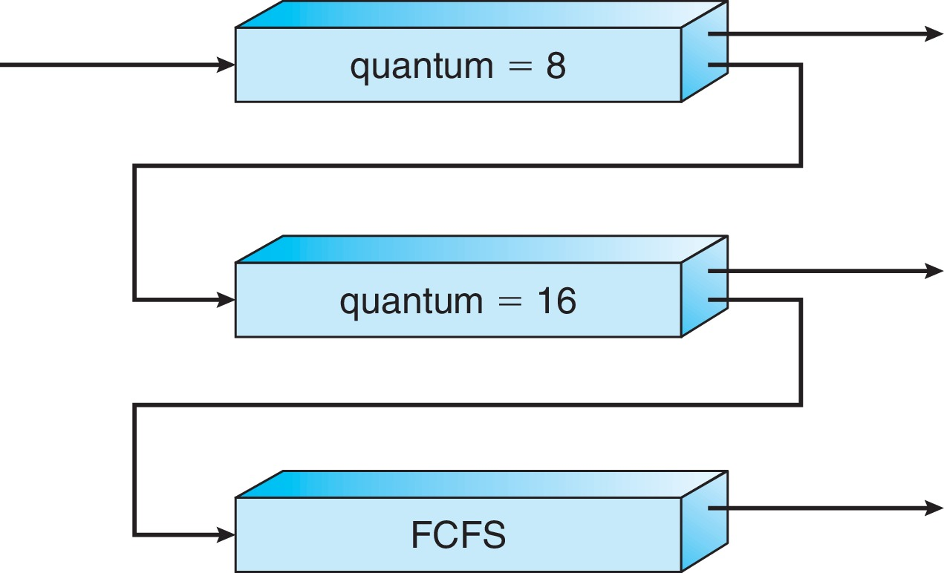
Example of Multilevel Feedback Queue
Three queues:
Q₀ – RR with time quantum 8 milliseconds
Q₁ – RR time quantum 16 milliseconds
Q₂ – FCFS
Scheduling
A new process enters queue Q₀ which is served in RR
When it gains CPU, the process receives 8 milliseconds
If it does not finish in 8 milliseconds, the process is moved to queue Q₁
At Q₁ job is again served in RR and receives 16 additional milliseconds
If it still does not complete, it is preempted and moved to queue Q₂

Slide 28
Thread Scheduling
Distinction between user-level and kernel-level threads
When threads supported, threads scheduled, not processes
Many-to-one and many-to-many models, thread library schedules user-level threads to run on LWP
Known as process-contention scope (PCS) since scheduling competition is within the process
Typically done via priority set by programmer
Kernel thread scheduled onto available CPU is system-contention scope (SCS) – competition among all threads in system

Slide 29
Pthread Scheduling
API allows specifying either PCS or SCS during thread creation
PTHREAD_SCOPE_PROCESS schedules threads using PCS scheduling
PTHREAD_SCOPE_SYSTEM schedules threads using SCS scheduling
Can be limited by OS – Linux and macOS only allow PTHREAD_SCOPE_SYSTEM

Slide 30
Pthread Scheduling API
#include <pthread.h>
#include <stdio.h>
#define NUM_THREADS 5
int main(int argc, char *argv[]) {
int i, scope; pthread_t tid[NUM THREADS];
pthread_attr_t attr;
/* get the default attributes */
pthread_attr_init(&attr);
/* first inquire on the current scope */ if (pthread_attr_getscope(&attr, &scope) != 0)
fprintf(stderr, "Unable to get scheduling scope\n");
else {
if (scope == PTHREAD_SCOPE_PROCESS)
printf("PTHREAD_SCOPE_PROCESS");
else if (scope == PTHREAD_SCOPE_SYSTEM)
printf("PTHREAD_SCOPE_SYSTEM");
else fprintf(stderr, "Illegal scope value.\n");
}

Slide 31
Pthread Scheduling API
/* set the scheduling algorithm to PCS or SCS */
pthread_attr_setscope(&attr, PTHREAD_SCOPE_SYSTEM);
/* create the threads */ for (i = 0; i < NUM_THREADS; i++)
pthread_create(&tid[i],&attr,runner,NULL);
/* now join on each thread */ for (i = 0; i < NUM_THREADS; i++)
pthread_join(tid[i], NULL);
}
/* Each thread will begin control in this function */
void *runner(void *param) {
/* do some work ... */
pthread_exit(0);
}

Slide 32
Multiple-Processor Scheduling
CPU scheduling more complex when multiple CPUs are available
Multiprocess may be any one of the following architectures:
Multicore CPUs
Multithreaded cores
NUMA systems
Heterogeneous multiprocessing

Slide 33
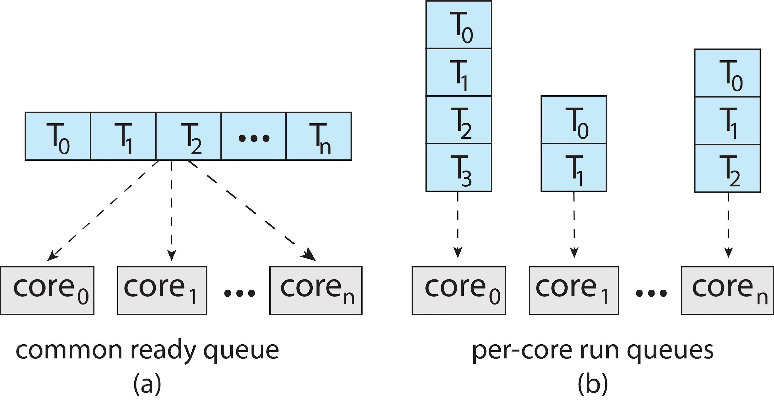
Multiple-Processor Scheduling
Symmetric multiprocessing (SMP) is where each processor is self scheduling.
All threads may be in a common ready queue (a)
Each processor may have its own private queue of threads (b)

Slide 34
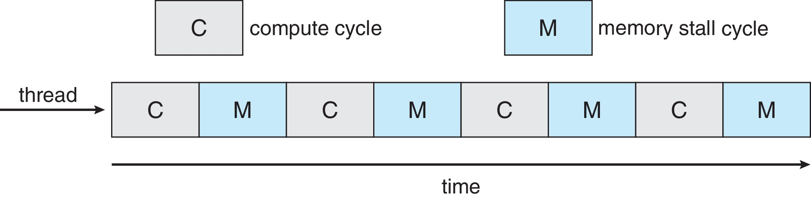
Multicore Processors
Recent trend to place multiple processor cores on same physical chip
Faster and consumes less power
Multiple threads per core also growing
Takes advantage of memory stall to make progress on another thread while memory retrieve happens
Figure

Slide 35
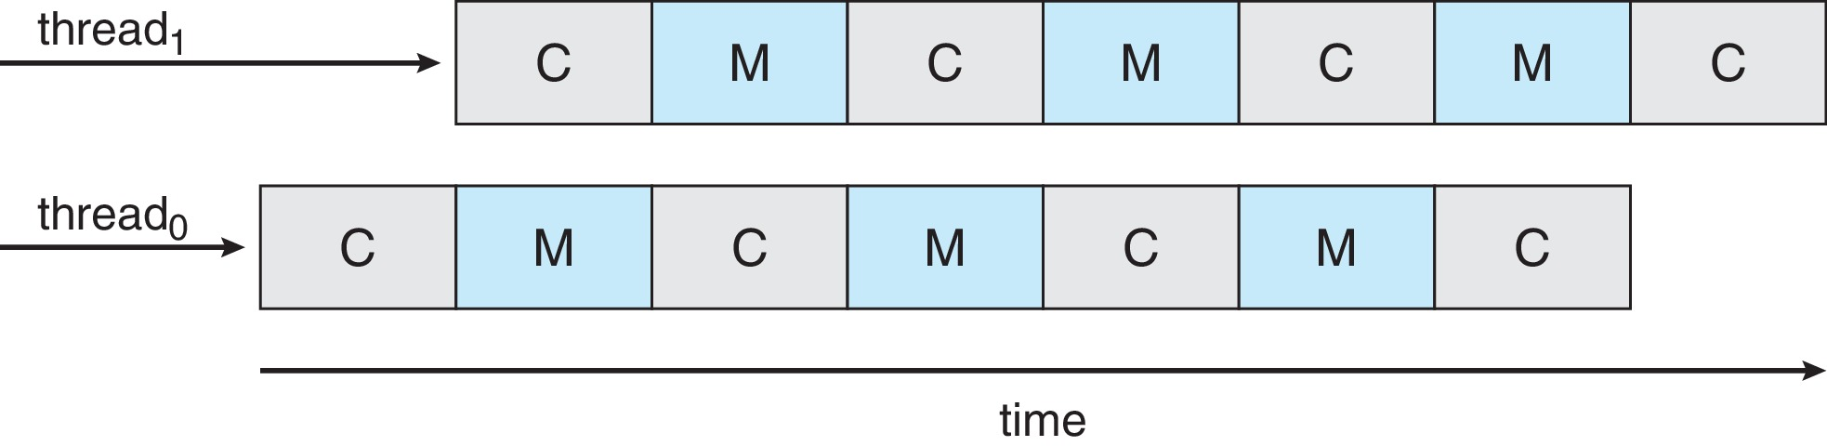
Multithreaded Multicore System
Each core has > 1 hardware threads.
If one thread has a memory stall, switch to another thread!
Figure

Slide 36
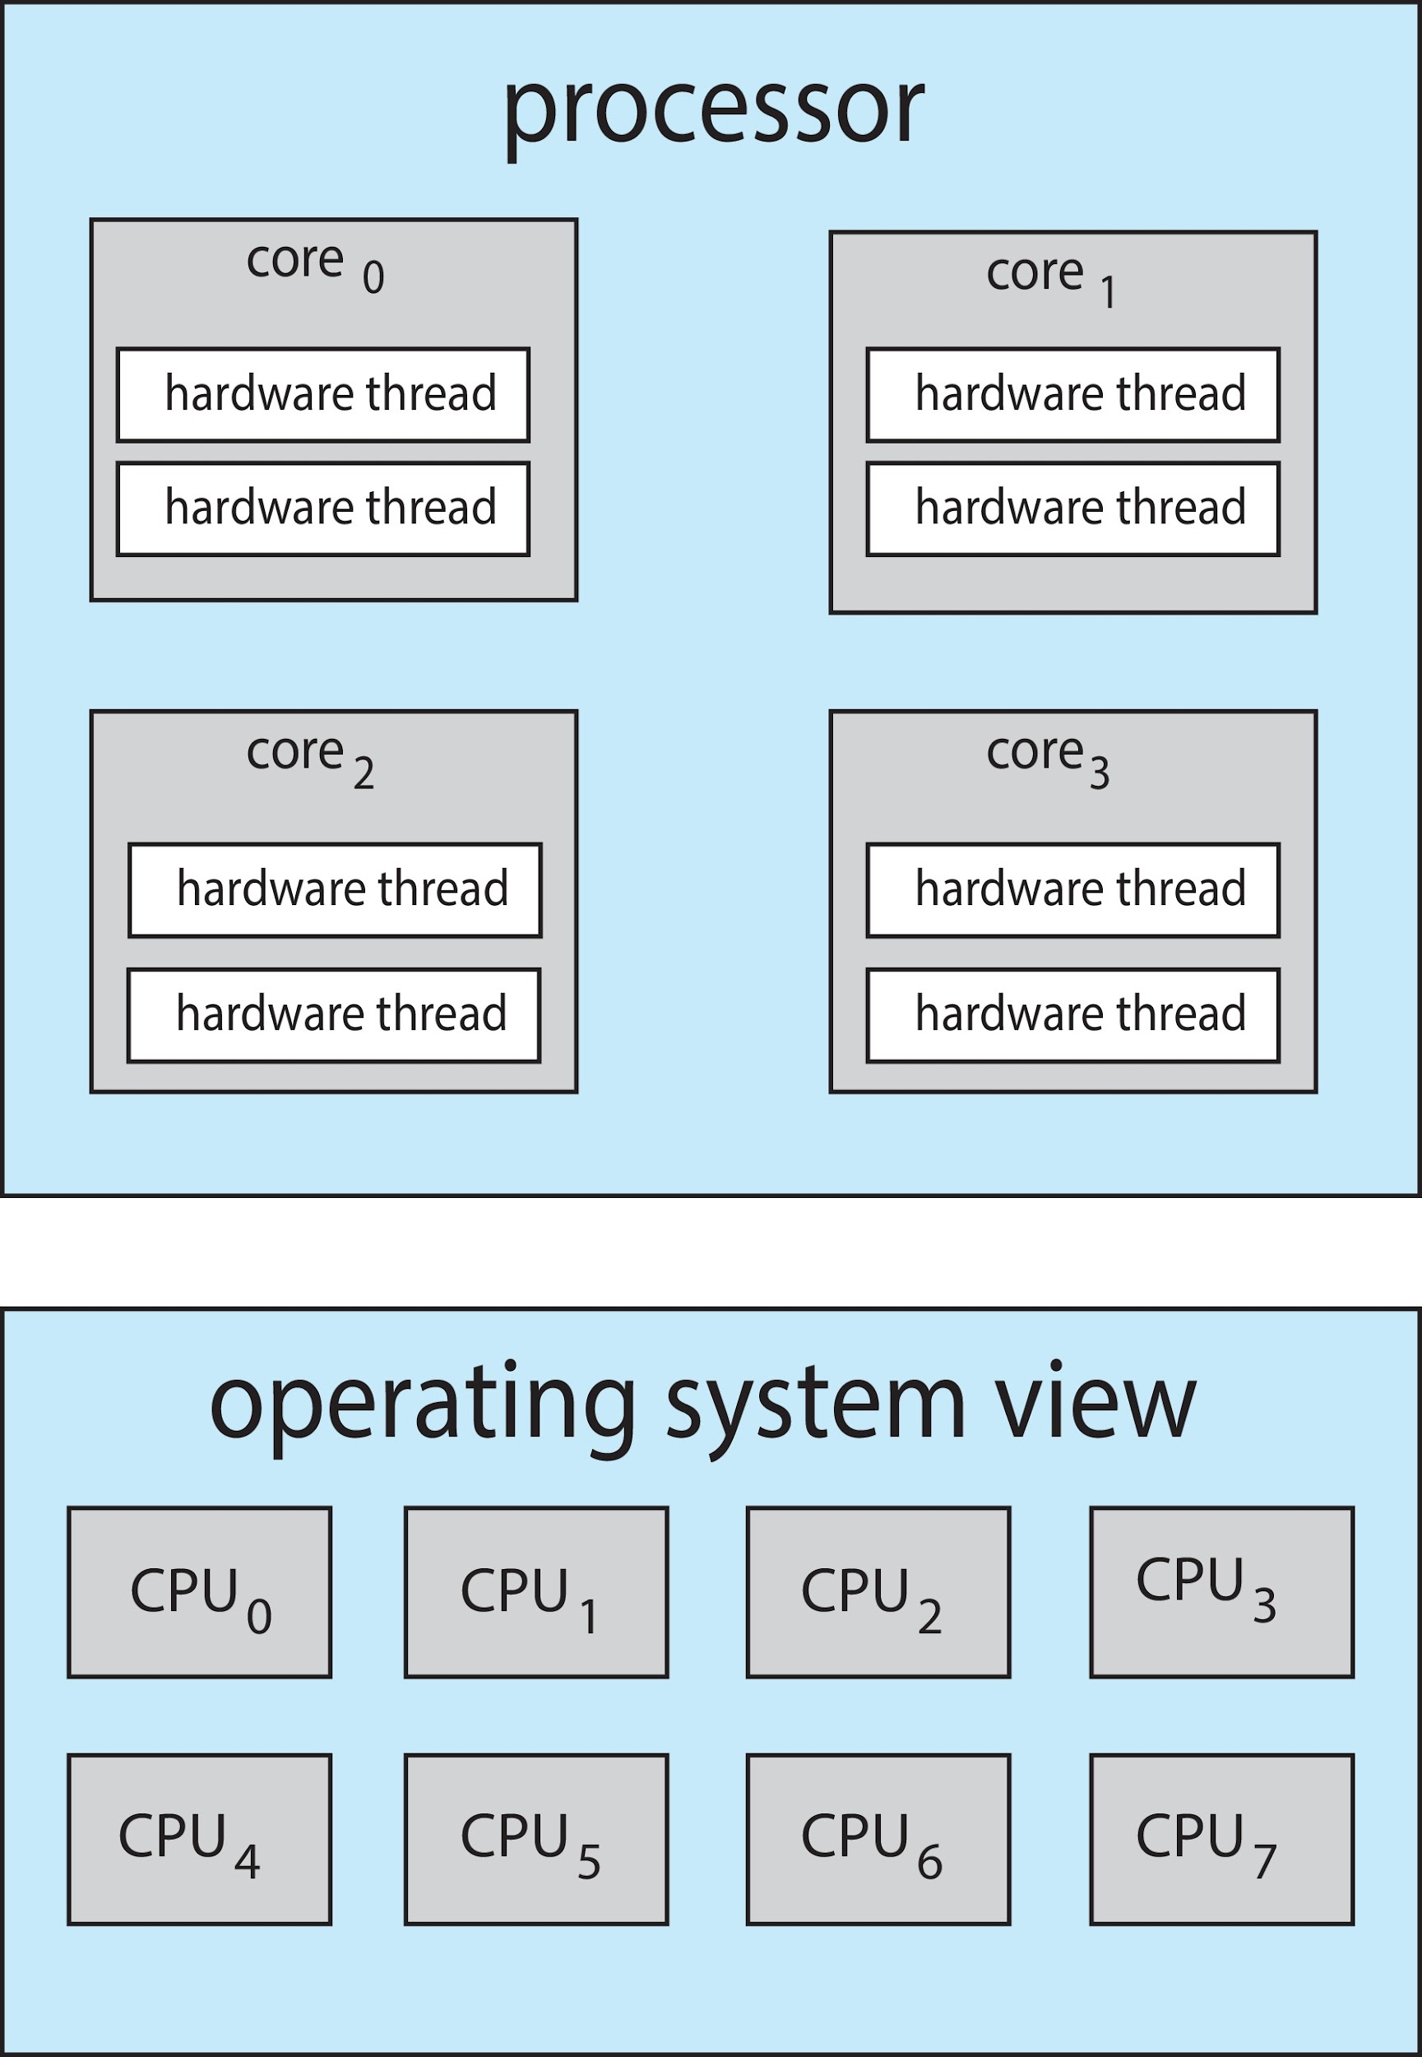
Multithreaded Multicore System
Chip-multithreading (CMT) assigns each core multiple hardware threads. (Intel refers to this as hyperthreading.)
On a quad-core system with 2 hardware threads per core, the operating system sees 8 logical processors.

Slide 37
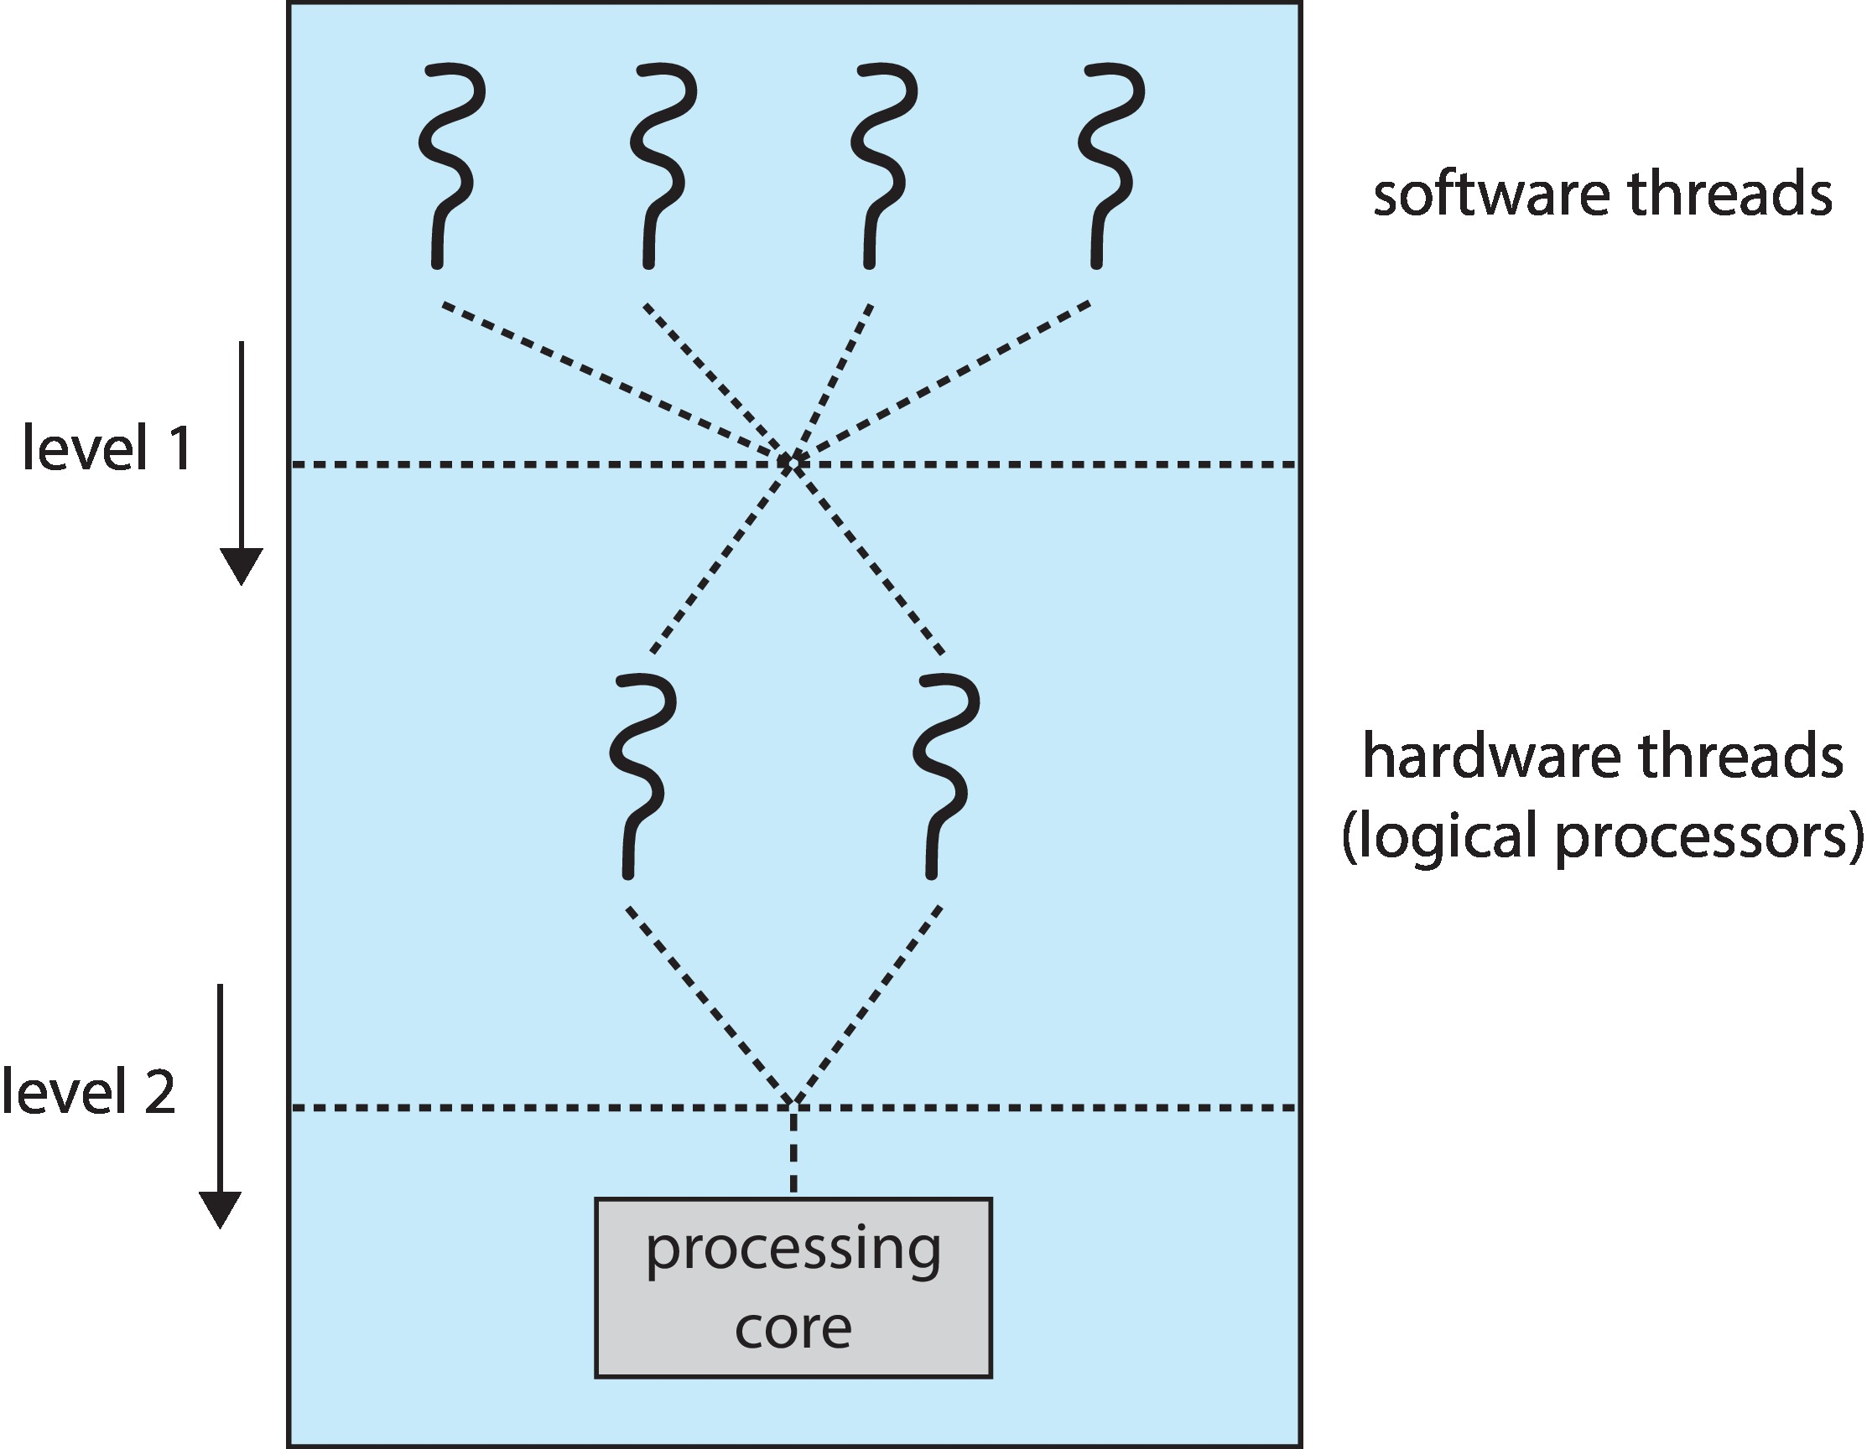
Multithreaded Multicore System
Two levels of scheduling:
The operating system deciding which software thread to run on a logical CPU
How each core decides which hardware thread to run on the physical core.

Slide 38
Multiple-Processor Scheduling – Load Balancing
If SMP, need to keep all CPUs loaded for efficiency
Load balancing attempts to keep workload evenly distributed
Push migration – periodic task checks load on each processor, and if found pushes task from overloaded CPU to other CPUs
Pull migration – idle processors pulls waiting task from busy processor

Slide 39
Multiple-Processor Scheduling – Processor Affinity
When a thread has been running on one processor, the cache contents of that processor stores the memory accesses by that thread.
We refer to this as a thread having affinity for a processor (i.e., “processor affinity”)
Load balancing may affect processor affinity as a thread may be moved from one processor to another to balance loads, yet that thread loses the contents of what it had in the cache of the processor it was moved off of.
Soft affinity – the operating system attempts to keep a thread running on the same processor, but no guarantees.
Hard affinity – allows a process to specify a set of processors it may run on.

Slide 40
Real-Time CPU Scheduling
Can present obvious challenges
Soft real-time systems – Critical real-time tasks have the highest priority, but no guarantee as to when tasks will be scheduled
Hard real-time systems – task must be serviced by its deadline

Slide 41
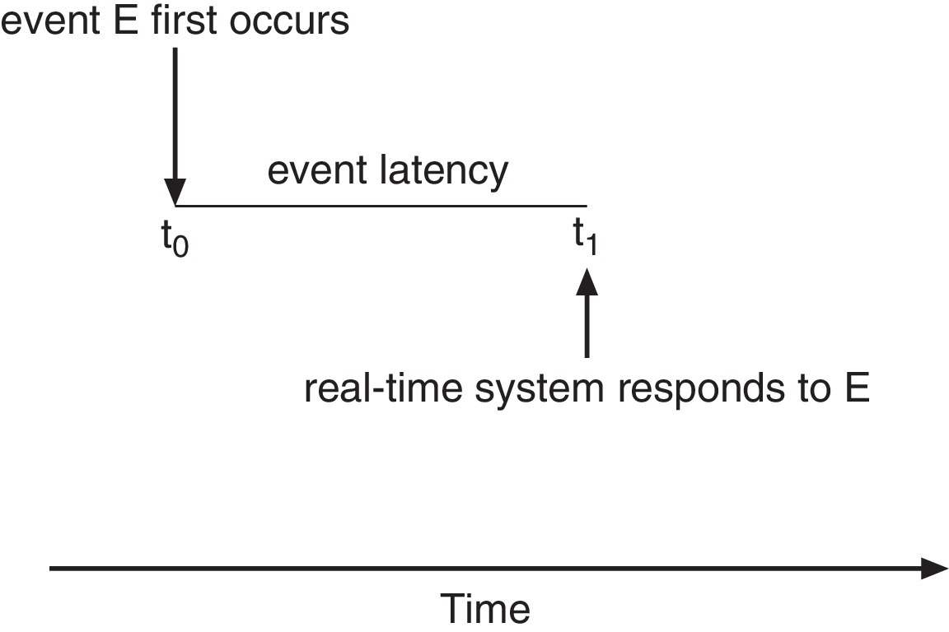
Real-Time CPU Scheduling
Event latency – the amount of time that elapses from when an event occurs to when it is serviced.
Two types of latencies affect performance
Interrupt latency – time from arrival of interrupt to start of routine that services interrupt
Dispatch latency – time for schedule to take current process off CPU and switch to another

Slide 42
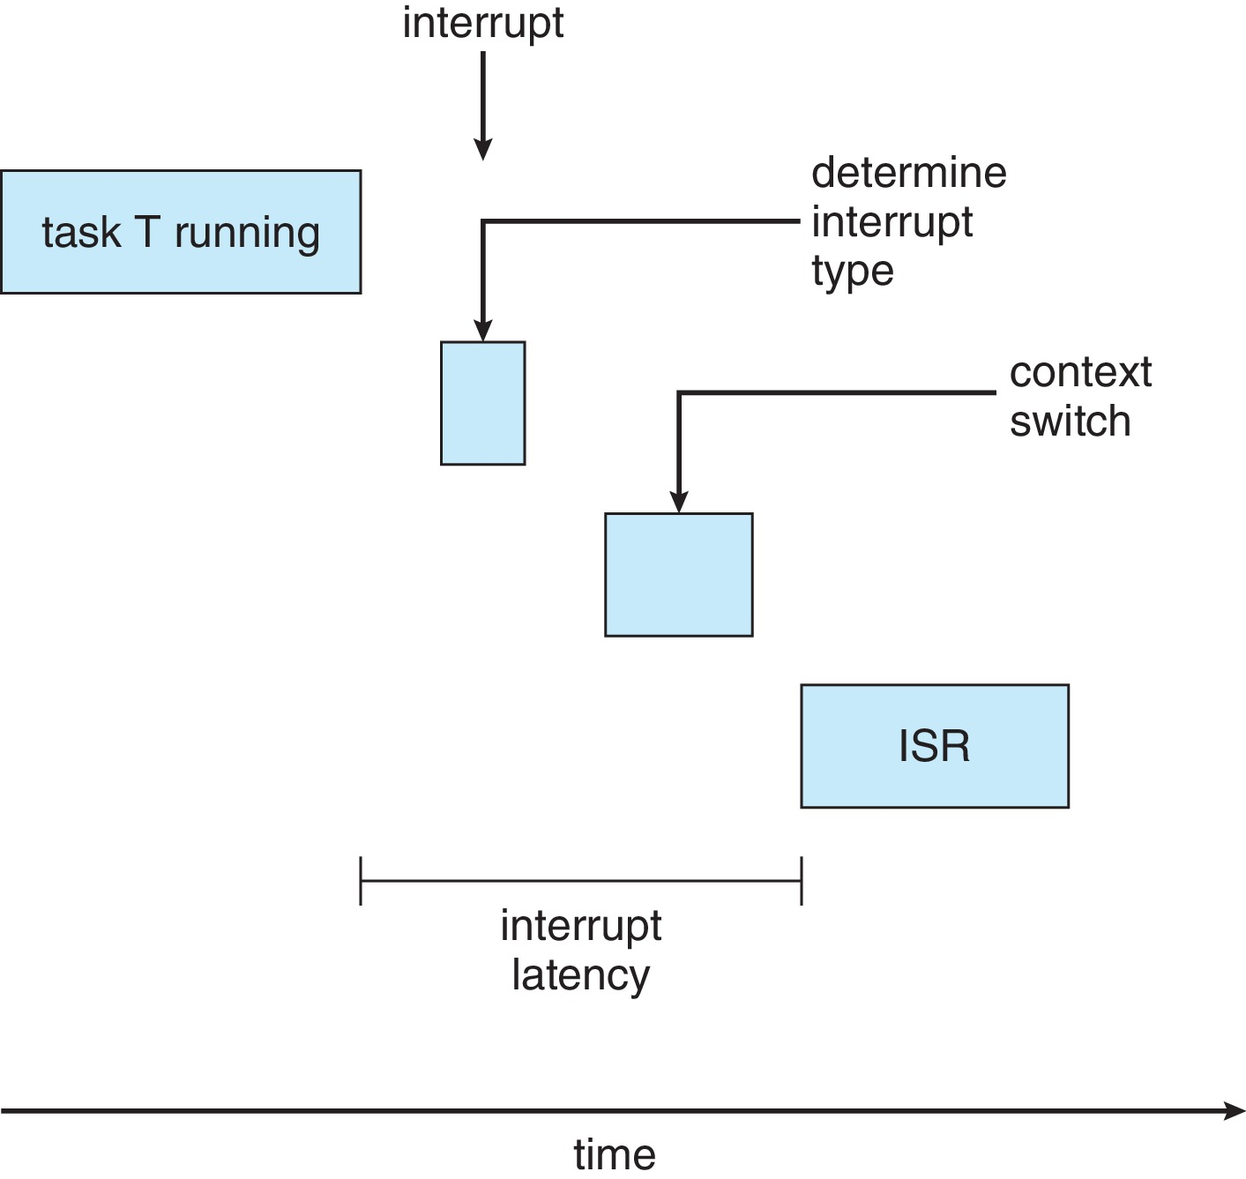
Interrupt Latency

Slide 43
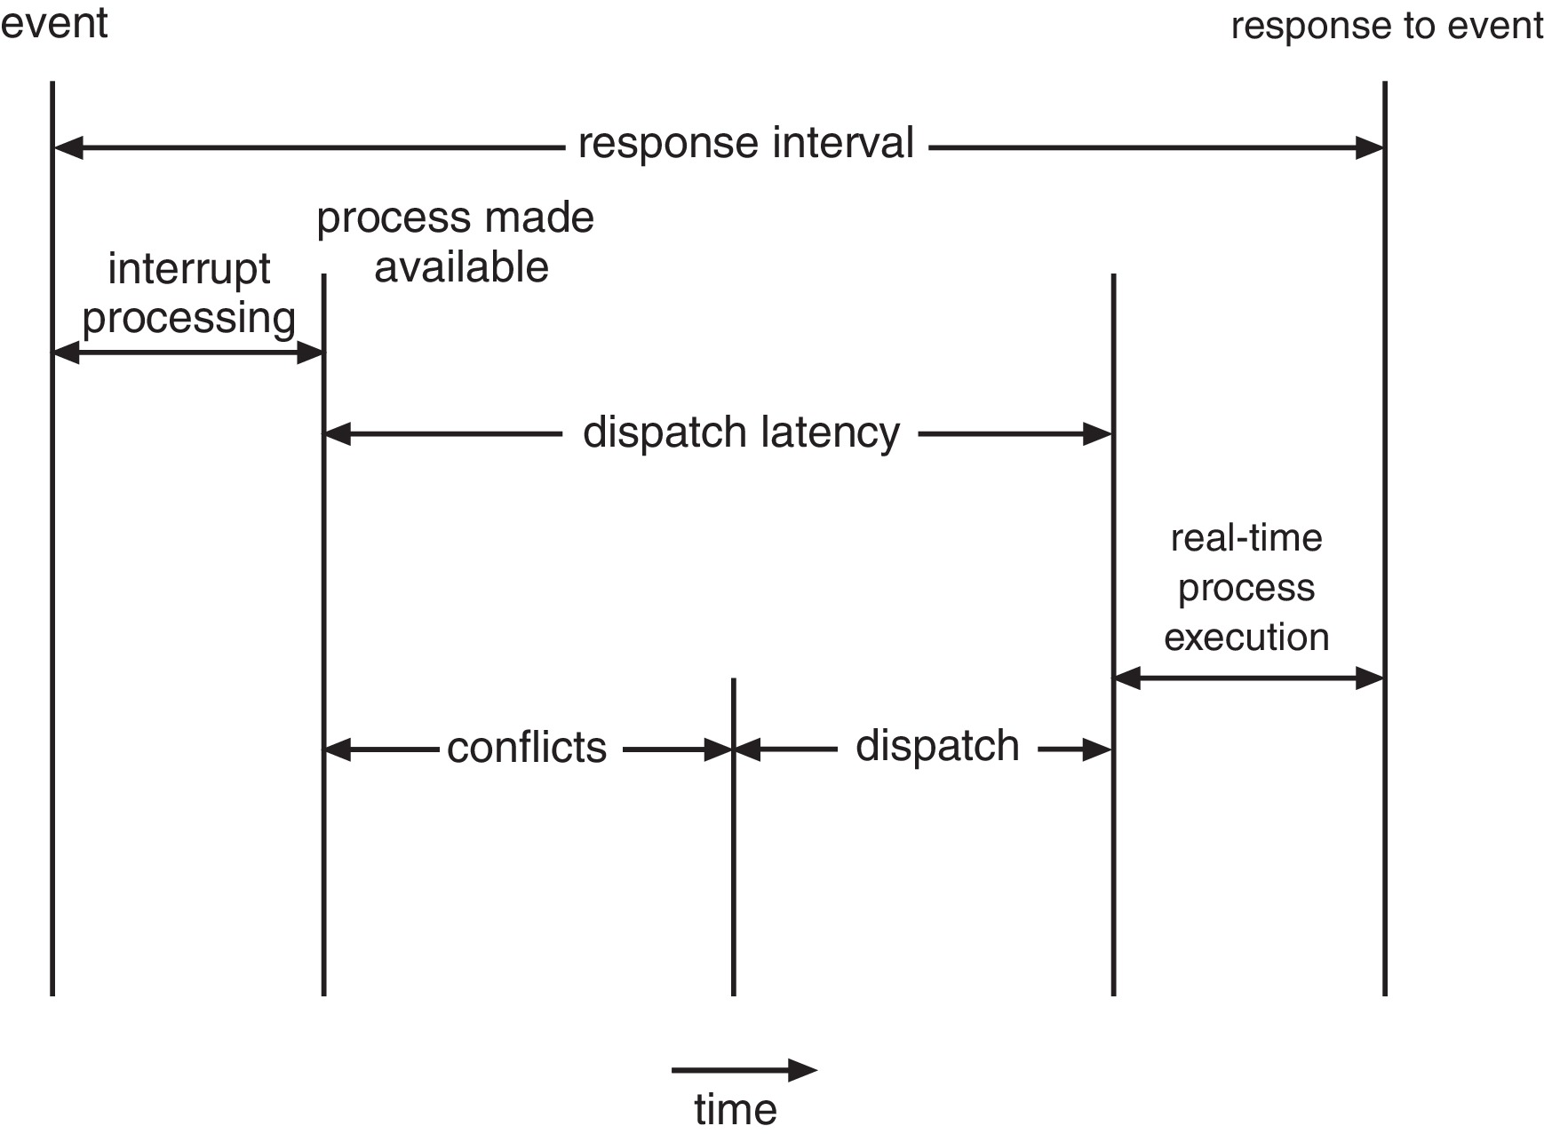
Dispatch Latency
Conflict phase of dispatch latency:
Preemption of any process running in kernel mode
Release by low-priority process of resources needed by high-priority processes

Slide 44
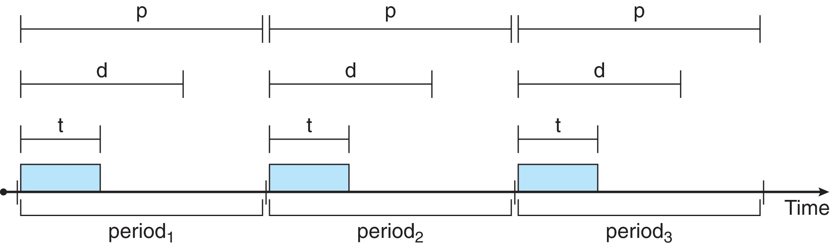
Priority-based Scheduling
For real-time scheduling, scheduler must support preemptive, priority-based scheduling
But only guarantees soft real-time
For hard real-time must also provide ability to meet deadlines
Processes have new characteristics: periodic ones require CPU at constant intervals
Has processing time t, deadline d, period p
0 ≤ t ≤ d ≤ p
Rate of periodic task is 1/p

Slide 45
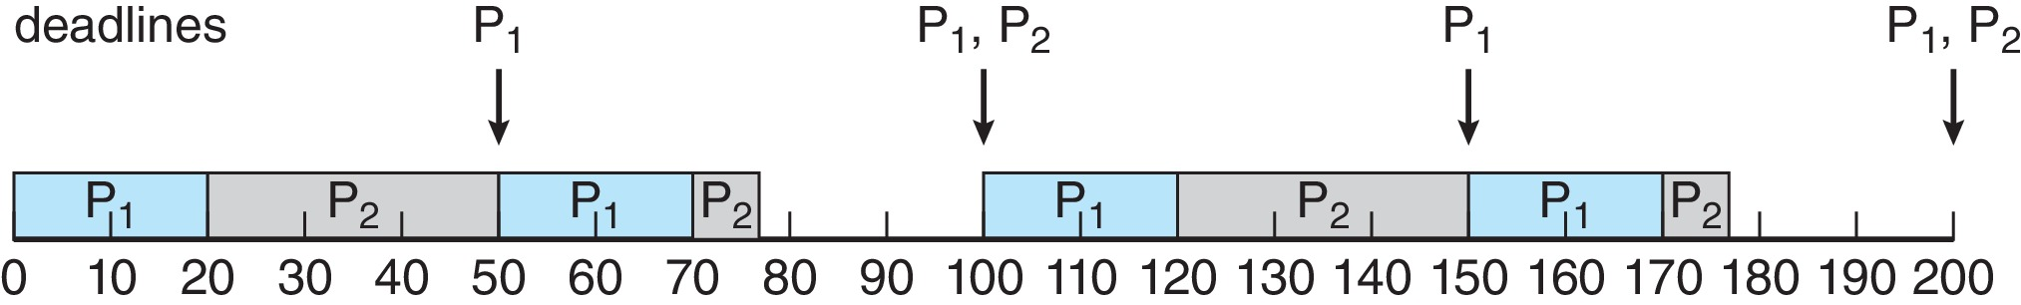
Rate Monotonic Scheduling
A priority is assigned based on the inverse of its period
Shorter periods = higher priority;
Longer periods = lower priority
P₁ is assigned a higher priority than P₂.
We have two processes, P1 and P2. The periods for P1 and P2 are 50 and 100, respectively— that is, p1 = 50 and p2 = 100. The processing times are t1 = 20 for P1 and t2 = 35 for P2. The deadline for each process requires that it complete its CPU burst by the start of its next period

Slide 46
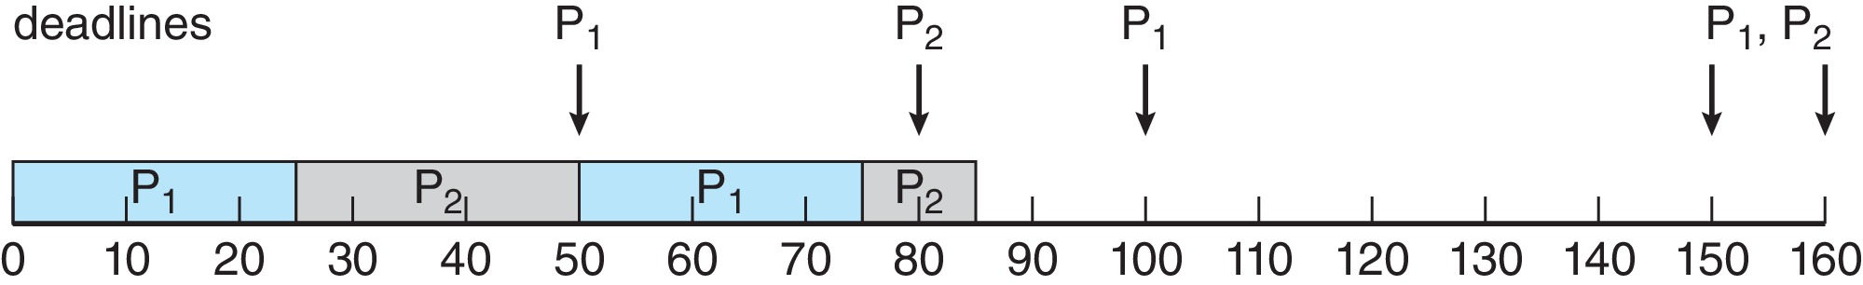
Missed Deadlines with Rate Monotonic Scheduling
Assume that process P1 has a period of p1 = 50 and a CPU burst of t1 = 25. For P2, the corresponding values are p2 = 80 and t2 = 35
Figure

Slide 47
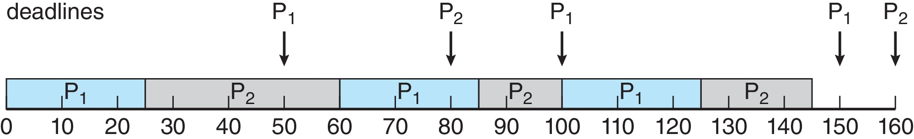
Earliest Deadline First Scheduling (EDF)
Priorities are assigned according to deadlines:
The earlier the deadline, the higher the priority
The later the deadline, the lower the priority
Recall that P1 has values of p1 = 50 and t1 = 25 and that P2 has values of p2 = 80 and t2 = 35.

Slide 48
POSIX Real-Time Scheduling
The POSIX.1b standard
API provides functions for managing real-time threads
Defines two scheduling classes for real-time threads:
SCHED_FIFO - threads are scheduled using a FCFS strategy with a FIFO queue. There is no time-slicing for threads of equal priority
SCHED_RR - similar to SCHED_FIFO except time-slicing occurs for threads of equal priority
Defines two functions for getting and setting scheduling policy:
pthread_attr_getsched_policy(pthread_attr_t *attr, int *policy)
pthread_attr_setsched_policy(pthread_attr_t *attr, int policy)

Slide 49
POSIX Real-Time Scheduling API
#include <pthread.h>
#include <stdio.h>
#define NUM_THREADS 5
int main(int argc, char *argv[])
{
int i, policy; pthread_t_tid[NUM_THREADS];
pthread_attr_t attr;
/* get the default attributes */
pthread_attr_init(&attr);
/* get the current scheduling policy */ if (pthread_attr_getschedpolicy(&attr, &policy) != 0)
fprintf(stderr, "Unable to get policy.\n");
else {
if (policy == SCHED_OTHER) printf("SCHED_OTHER\n");
else if (policy == SCHED_RR) printf("SCHED_RR\n");
else if (policy == SCHED_FIFO) printf("SCHED_FIFO\n");
}

Slide 50
POSIX Real-Time Scheduling API (Cont.)
/* set the scheduling policy - FIFO, RR, or OTHER */ if (pthread_attr_setschedpolicy(&attr, SCHED_FIFO) != 0)
fprintf(stderr, "Unable to set policy.\n");
/* create the threads */ for (i = 0; i < NUM_THREADS; i++)
pthread_create(&tid[i],&attr,runner,NULL);
/* now join on each thread */ for (i = 0; i < NUM_THREADS; i++)
pthread_join(tid[i], NULL);
}
/* Each thread will begin control in this function */
void *runner(void *param) {
/* do some work ... */
pthread_exit(0);
}

Slide 51
End of Chapter 5

